Slide 1

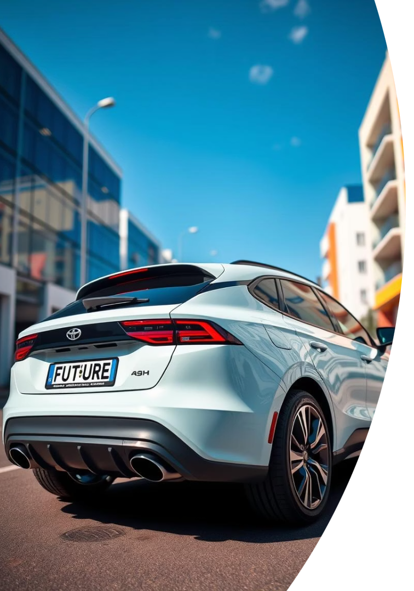
Vehicle Number Plate Detection Using Python & OCR
An efficient solution for identifying vehicle plates with computer vision

Slide 2

Purpose of the Project
Identify Plates
Extract Text
Detect and localize vehicle license plates in images
Convert plate images into readable text using OCR
Automate Data
Real-Time Use
Facilitate automated vehicle tracking and record keeping
Support quick decision-making in security and traffic systems

Slide 3
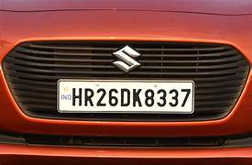
Google Colab Link for Code:
https://colab.research.google.com/drive/18-rM9_udtHZSqtz-lGEpRFqA8b8Z08ZP
Image:

Slide 4
Tools & Libraries Used
Python
OpenCV
Tesseract OCR
NumPy
Core language for image processing and integration
Image manipulation and plate detection algorithms
Accurate optical character recognition for text extraction
Matrix operations and data handling

Slide 5





How It Works: Step-by-Step
Load Image
Input vehicle photo or video frame
Preprocessing
Convert to grayscale and apply noise reduction
Plate Detection
Use contour detection and filtering to locate plate
Character Segmentation
Isolate characters for recognition
OCR Extraction
Recognize text from segmented characters

Slide 6
Image Processing Workflow
Mount Google Drive to access external files securely.
Access images stored in a designated Google Drive folder.
Load Required Libraries:
Use OpenCV for image processing.
Use EasyOCR for text recognition.
Set the path to the folder containing car number plate images.
Process each image sequentially in the folder, performing detection and recognition.

Slide 7
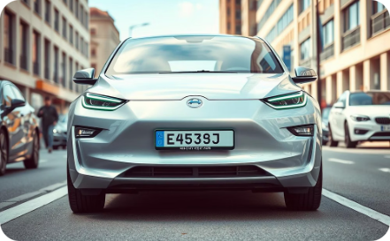
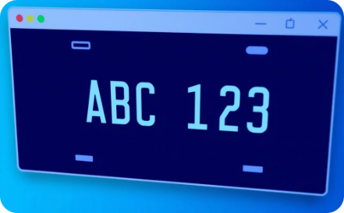
Output Samples
Detection Highlight
Text Extraction
Bounding box accuracy demonstrated
Accurate readable string from image

Slide 8
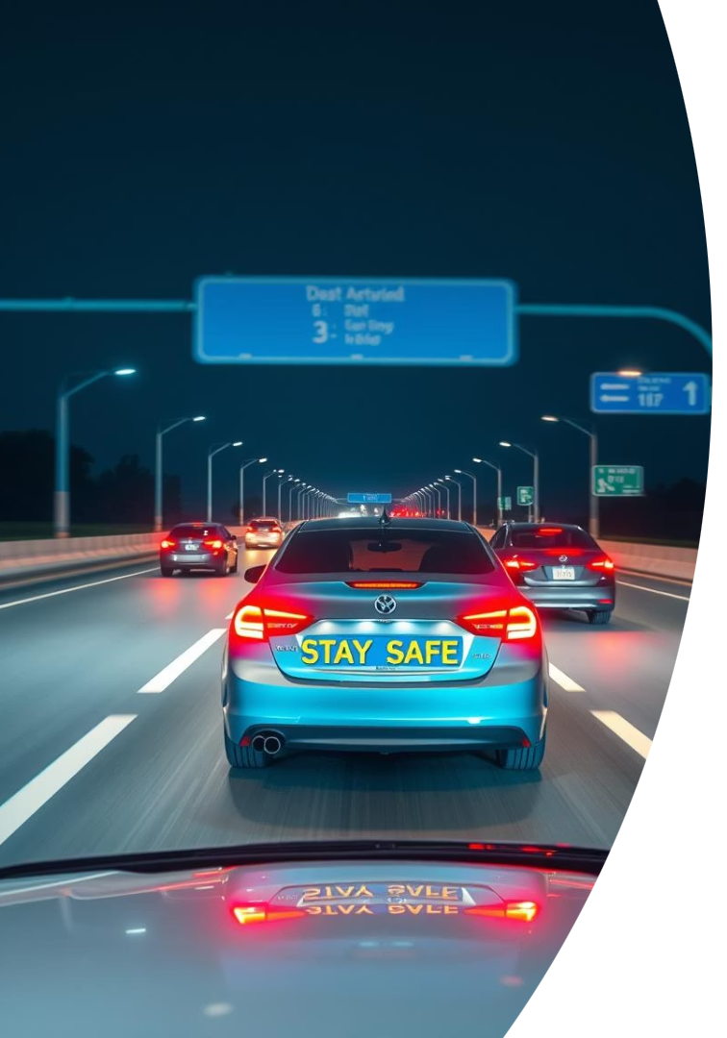
Applications & Use Cases
Traffic Monitoring
Automated toll collection and vehicle counting
Parking Management
Entry and exit logging in private and public lots
Law Enforcement
Identify stolen vehicles and traffic violations
Logistics
Fleet tracking and delivery verification

Slide 9




Key Takeaways & Next Steps
Reliable Detection
Effective OCR
Accurate license plate localization
1
2
High-fidelity character recognition
4
3
Future Growth
Real-World Use
Expand features and efficiency
Robust for diverse scenarios

Slide 10


Conclusion & Future Improvements
Improve Accuracy
Refine detection with deep learning models
Speed Optimization
Enable real-time detection on edge devices
Multilingual OCR
Support various plate designs and scripts
Integration
Combine with automated databases and alert systems

